Slide 1
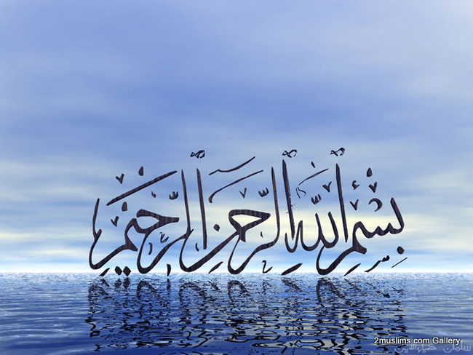

Slide 2

Lecture
INTRODUCTION TO QURANIC STUDIES

Slide 3
Introduction to Holy Quran and Its Compilation
By Muhammad Ajmal Farooq

Slide 4
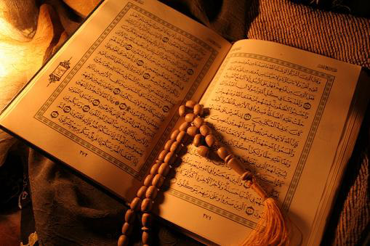
Out Lines
BASIC CONCEPT OF THE HOLY QURAN
HISTORY OF THE HOLY QURAN
ULOOM UL QURAN

Slide 5
Sub Division
Basic Concept of Holy Quran
Introduction to Holy Quran
Meaning of the word “Quran” and Definition
The period of Revelation
First Revelation
The Subject of the Qur’an
History of the Holy Quran
Compilation of the holy Quran
Quranic distinguish
The Rights Of Qur’an
Uloom-ul-Quran
Two Patren of Transmission of the Holy Quran
Kinds and Categories of revelation
The Theme of the Quran
The Quranic order
Makki and Madni Surahs

Slide 6
Introduction to Holy Qura’n
The Divine book
Last revelied to the last Prophet (PBUH) for last Ummah
The Source of Islamic Law
Qura’n as guidance of humanity
Qura’n as cod of life
Qura’n as shifa against diseases

Slide 7
Meaning of the word “Quran” and Definition
Etmological Meaning of the word Qura’n
Technically it means and Definition

Slide 8
Etmological Meaning of the word Qura’n
This word قرأ نis etmology derived from the (قرأ)ق.ر.أ. with its basic Arabic roots
The word (qiraah) is also derived from the same roots. So the meaning of (qiraah) is reading and recitation. The word Qur’n is the tense of exaggeration. So the literal meaning of the word Qura’n is the widely read book. So:
Qira’ah means: reading and recitation.
And Qura’n means the widely read book.
No doubt that the holy Qura’n is recited widely.

Slide 9
Technically it means and Definition
One of the holy books of Allah which has been revealed to the holy prophet Muhammad (ﷺ) in 23 years.
The revelation of the Qur’an started through Wahi (inspiration) from Allah (Almighty).
Definition:
« هو كلام الله المعجز , المنزل على خاتم الأنبياء و المرسلين بواسطة الأمين جبريل عليه السلام, المكتوب في المصاحف , المنقول إلينا بالتواتر, المتعبد بتلاوته , المبدوء بسورة الفاتحة, المختتم بسورة الناس »
“IT IS THE WORD OF ALLAH AND IS THE MOST MIRACULOUS, REVEALED ON THE LAST PROPHET (PEACE BE UPON HIM) BY MEANS OF ANGEL JIBRAEL (ALAI SALAAM), WRITTEN IN SCRIPTURES, TRANSMITTED TO US THROUGH RECURRENT SOURCES, WORSHIPPED BY RECITATION, STARTING FROM SURAH FATIHA AND ENDING ON SURAN NAAS.”

Slide 10
First Revelation
Cave Hera is in Jabl-e-Noor (Noor Mountain) on the road to Mina about 3 miles to the East of Holy Macca.
The Prophet was about 40 years old when Angel Jibrail brought the first revelation from Allah Almighty.
The first revealed verses of the Qur’an are the first 5 verses (Ayats) of Surah Al Alaq.

Slide 11
The period of Revelation
The period of revelation of the Qur’an is 22 years, 5 months and 14 days about 23 years.
The last verse was revealed shortly before the Prophets (ﷺ) transferred to Allah in Arafat. It is the third verse of Surah Al Maidah.

Slide 12
The Subject of the Qur’an
The subject of the Qur’an is ''Man" (the one created in the best of form) and his ultimate goal in life.
Main goal of the man's creation is “to worship of Allah”.
Man can achieve “the well of Allah” to follow Qur’an.

Slide 13
History of the Holy Quran
Compilation of the holy Quran:1
In the time of Prophet (ﷺ): His instructions to katibeen-e-wahi.
In the time of Prophet (ﷺ): His Compilation
In the time of Prophet (ﷺ): Quranic Dialect
Compilation of the holy Quran:2
Compilation of the holy Quran:3

Slide 14
Compilation of the holy Quran:1
The Qur’an was recorded and memorized all together
In Arabia, the people had the habit of memorizing due to their prevailing oral culture, so there were 100’s of 1000’s of people who had memorized the Holy Qur’an in the life time of Prophet Muhammad (ﷺ)
That oral culture is continuing without any gap till today. There were millions of Muslims in every single frame of history in the Muslim world who had memorized the Holy Qur’an completely
Similarly, the written copies of the Qur’an without a single letter difference, were available everywhere

Slide 15
In the time of Prophet (ﷺ) His instructions to katibeen-e-wahi.
Memorization regular – genealogy trees memorized
Prophet Muhammad (ﷺ) himself supervised and authenticated the written texts of the Qur’an
Whenever the Prophet received a revelation, he would first memorize it himself
Instruct his Companions who would also memorize it.
The Prophet would immediately ask the scribes to write down the revelation
After receiving each revelation, he would repeat it to his Companions. They would write down the revelation, and he would recheck by asking them to read what they had written.

Slide 16
In the time of Prophet (ﷺ) His Compilation
The Qur’an was not compiled by the Prophet (ﷺ) in the chronological order of revelation. The order and sequence of the Qur’an too was Divinely inspired and was instructed to the Prophet (ﷺ) by Allah (swt)
Every Ramadhaan all the portions of the Qur’an were revised
It is therefore clearly evident that the Qur’an was compiled and authenticated by the Prophet himself during his lifetime, both in the written form as well as in the memory of several of his Companions.
Many Companions of the Prophet used to write down the revelation of the Qur’an on their own whenever they heard it from the lips of the Prophet (ﷺ).

Slide 17
In the time of Prophet (ﷺ) Quranic Dialect
Muhammad (ﷺ) seems to have adopted this method to satisfy the desire of the leading tribes to have a Qur'an in their own dialect; The Qur'an was first revealed in the dialect of the' Quaraish, which was the Prophet's (ﷺ) native tongue; but when the Prophet (ﷺ) saw that the people of other tribes recited it with difficulty, then he obtained permission from God to extend its currency by allowing it to be recited in all the chief dialects of Arabia, which ,were seven:-Quraish, Taiy, Hawazim, Yaman, Saqif, Huzail and Banu Tamim. Everyone of these tribes accordingly read the Qur’an in its own dialect, till the time of 'Usman, when those differences of reading ,were prohibited

Slide 18
Compilation of the holy Quran:2
In the time of AbuBakar siddeeq (r.a.)
back ground for the compilation: (Reason for the compilation).
Yamama war and Hazrat Umar ‘s proposal.
Hazrat zaid bin sabit and the responsibility.
Steps taken for the compilation
Collection of the personal material.
Hazrat zaid’s verification and comparing with the manuscript he had.
Hazrat Umar and Hazrat zaid were hafizan-e-Qura’n.
Two witnesses

Slide 19
Compilation of the holy Quran:3
The different contents of the Qur’an during the period of the third Caliph Usman (r.a.).
Usman (r.a.) borrowed the original manuscript of the Qur’an, from Hafsha (r.a.). Usman (r.a.) ordered four Companions who were among the scribes who wrote the Qur’an when the Prophet (ﷺ) dictated it, led by Zaid bin Thabit (r.a.) to rewrite the script in several perfect copies on Quraishi dialect.
Usman (r.a.) only appealed to the people to destroy all these copies which did not match the original manuscript of the Qur’an in order to preserve the original text of the Qur’an. Two such copies of the original Qur’an authenticated by the Prophet are present to this day, one at the museum in Tashkent and the other at the Topkapi Museum in Istanbul, Turkey.

Slide 20

Quran is a principle to distinguish
Guidance and misguidance.
Iman & Kufr.
Islam & Jahiliyyah.
Acts which bring pleasure or displeasure of Allah.
Truth & falsehood.
Halal and Haram.
Tauhid and Shirk.

Slide 21
The Rights Of Qur’an
Scholars say that to leave Qur’an is not to do any of these:
Believe in it
Read it
Understand it
Deliberate in its verses
Act upon it
Spread it
THE RIGHTS OF QUR’AN

Slide 22
ULOOM-UL-QURAN (SCIENCE OF QURAN)

Slide 23
ULOOM-UL-QURAN
Two Patren of Transmission of the Holy Quran
Philosophy behind the gradual revelation
Kinds and Categories of revelation
The Theme of the Quran
The Quranic order
Makki and Madni Surahs

Slide 24
Two Patren of Transmission of the Holy Quran
Two words used in the holy Qur’n in this regard; Inzal and Tanzeel.
Inzal means: transmission in one ocassionإنا أنزلناه فى ليلة القدر“ while Tanzeel means gradual revelation .“ونزَّلناه تنزيلا“
The holy Qura’n was transmitted twice;
Full transmission.
Gradual revelation.
From lawh-e-mahfooz to bait-ul-mamoor. (inzal)
From bait-ul-mamoor to the holy prophet (ﷺ) (tanzeel)
Philosophy behind the gradual revelation?

Slide 25
Philosophy behind the gradual revelation
Muhammad (ﷺ) was ummy.
Difficult situation of revelation.
To conceal the Prophet (ﷺ) again and again.
To be according to the natural process.
Answers, awareness and incidents. They happened again and again.

Slide 26
Kinds and Categories of revelation
Gabraeel (a.s.)حٖضرت جبرائیلؑ himself in his own appearance.
In the appearance of dihia kalbiدحية كلبى .
Only sounds.صلصلة الجرس (difficult form)
Direct conversation in dreams, Awakening
Inspiration.
categories of revelation
Recited
the holy Qura’n.وحی متلو
Non recited:
hadeeth and hadeeth qudsiوحی غیرمتلو.

Slide 27
The Theme of the Quran
The theme of the Quran consists broadly of three fundamental beliefs. They are:
1. Tawhid - Allah and predestination
2. Risalah - Angels of Allah, Books of Allah and Messengers of Allah
3. Akhirah - Life after Death and the Day of Judgement

Slide 28
The Quranic order
Tauqeefi توقیفی
Nuzooliنزولی
The holy Qura’n was recorded only according to Tarteeb-e- Tauqeefi (ترتیبِ توقیفی)not Nuzooli (نزولی). Because the compilation is according to lawh-e-Mahfooz (لوح محفوظ) while the revelation is according to the circumstances

Slide 29
Makki and Madni Surahs
their definition.
Before and after the migration
their features.
Makki surahs Madni surahs
mostly brief mostly long
O people o believers
Beliefs injunctions.
Previous incidents. Jihad.

